Slide 1
Image based Food size and calories estimation
Group name : Mystic-gang
Abhinav Mamidipelly
Harsha Vardhan Reddy Goli
Udhaya Kumar Gutta
Prakyath Reddy Kandimalla

Slide 2
Abstract
Deep Learning is a part of the Artificial Intelligence that will used to build neural model features for prediction of the data from the unstructured data.
By using the Deep Learning model, here we are proposing the concept of Image based food identification for calorie estimation.
In this model we are using CNN (Convolutional Neural Networks) for prediction of the food item from the image.
Based on the food name from the image we calculate the calories of the of food item.
Based on the collection of the image dataset for training using CNN we can get the accurate results.

Slide 3
INTRODUCTION
In this project we focus on the identification of the calories using CNN approach. Generally in machine learning techniques are depends on the four level approaches
First step is collection of the Input data. In this step we collect the input records which are labeled and supervised data.
In second step, Feature Extraction is the process of identify the features for classifications.
We define the class labels and other attributes which are depend on the class labels, the analyzers will define the feature selections model.
Next step classify with any Machine learning algorithm. Based on the classification in the classification algorithm we can predict the result according to the given test data. In Fig 1 described clearly about the basic Machine Learning technique.

Slide 4
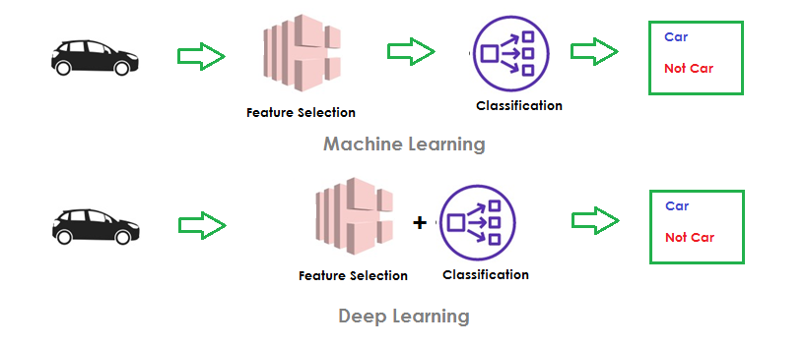
Machine Learning vs. Deep Learning

Slide 5
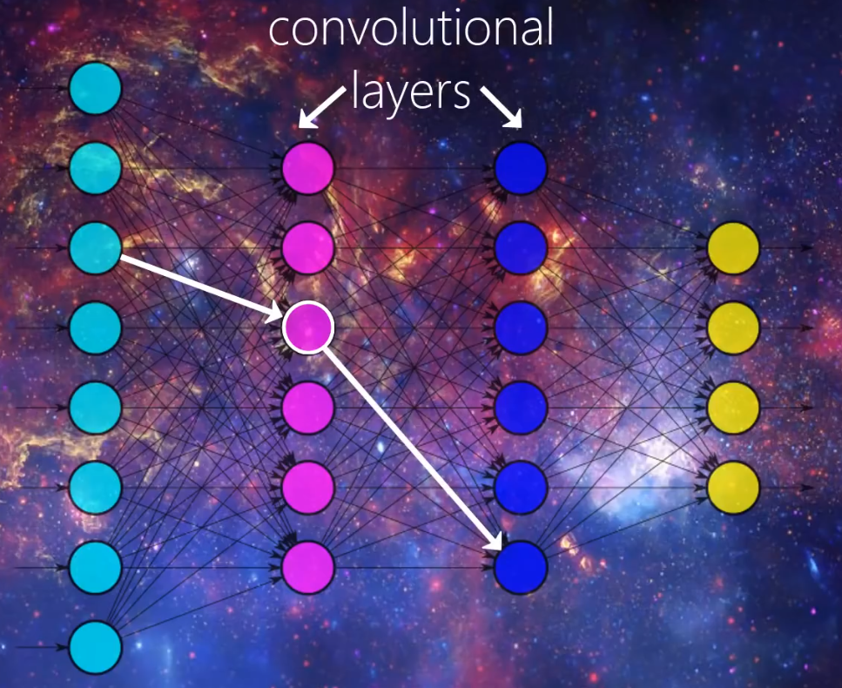
Convolutional Neural Networks
Convolutional Neural Network (CNN) is a special type of Neural Network used effectively for image recognition and classification.
For object identification CNN models have achieved lot of goals by comparatively Machine Learning models.
Many applications have implemented CNN models for object identifications like face recognitions, identification facial expression etc.
By taking motivations of those literatures we are implementing food image identification for calories detection.

Slide 6
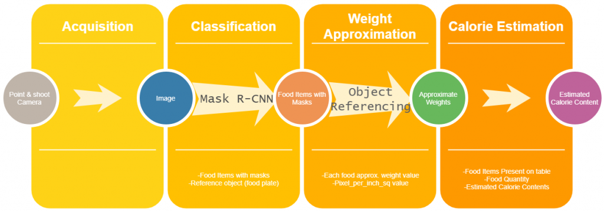

Slide 7
Project Plan
In this model we will be using CNN (Convolutional Neural Networks) for prediction of the food item from the image.
Based on the food name from the image we will calculate the calories of the of food item.
Based on the collection of the image dataset for training using CNN we can get the accurate results. We identify problem of food calorie estimation.
We identify the problems in machine learning model for static feature selection and also identify the advantages of CNN model based on dynamic feature selection.

Slide 8
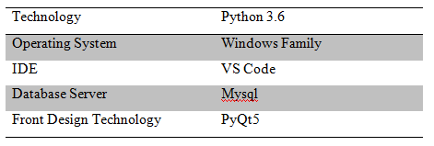
Project Requirements
In our research, we will build our system in desktop-based application. We will be using Python as a programming language and from Python API’s and PyQt5 concepts for building GUI components.
For frontend we will design our application with PyQt5 Tools.
For backend to store our data we will be using MySQL server for performing RDBMS concepts from our application.

Slide 9
Risk Management
For dataset collection, generally for classifying the image object dynamically with dynamic collection features of the objects is very risk.
We need to collect the lots of images for an object like ‘Ice Cream’.
For User interface we need to build a desktop application.
In desktop-based application we cannot satisfy the user expectation in terms of GUI components because of we don’t have much GUI components in the desktop frontend language.
Few food items look same may cause risk in finding difference between them. for this we need to give more details about it and we can't

Slide 10
Risk Monitoring and Control
Collection of dataset.
Training of the dataset.
Identify new risks.
Track risk response.

Slide 11
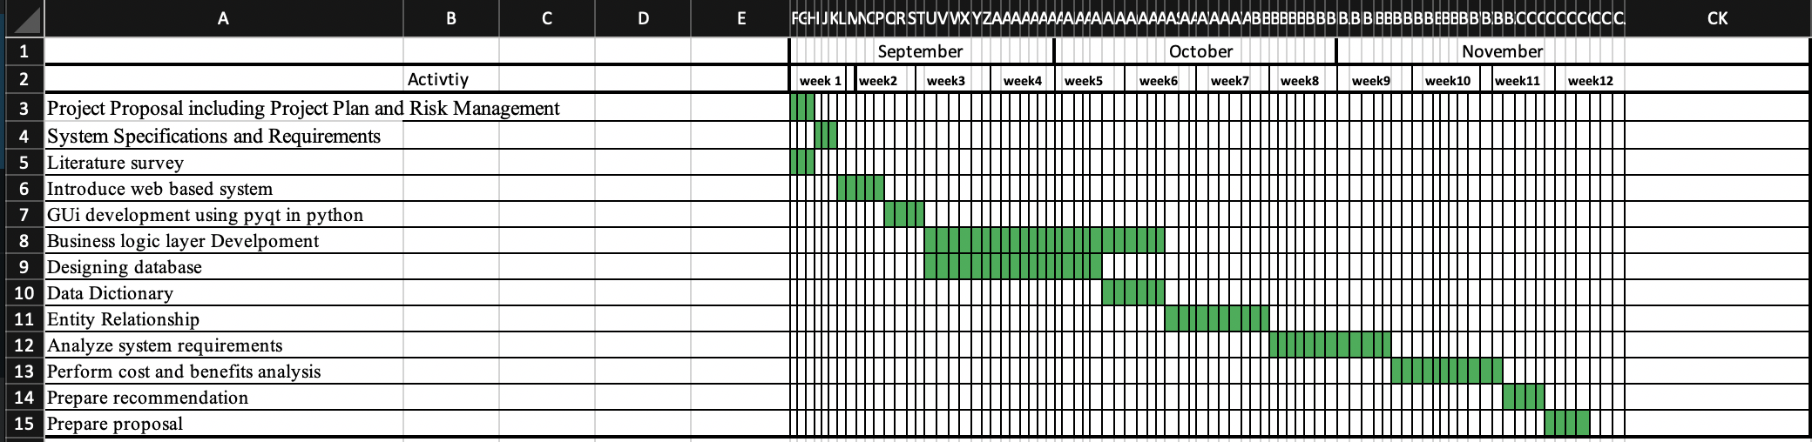

Slide 12
Roles
Member Name | Contribution Description | Overall Description (%) | Roles
Abhinav Mamidipelly | Software Requirements, Plan | 25 | Back-end and Databases
Harshavardhan Reddy Goli | Project Plan | 25 | Front-end and Back end
Prakyath Reddy Kandimalla | Related Work | 25 | Full-Fledged Front end
Udhaya Kumar Gutta | Risk Management | 25 | Full-Fledged Back end

Slide 13
REFERENCES
[1] T. Miyazaki, De. S. G. Chamin, and K. Aizawa, “Image-based calorie content estimation for dietary assessment,” in IEEE International Symposium on Multimedia, pp. 363–368, 2011.
[2] M. Chen, Y. Yang, C. Ho, S. Wang, S. Liu, E. Chang, C. Yeh, and M. Ouhyoung, “Automatic chinese food identification and quantity estimation,” in Proc. of SIGGRAPH Asia Technical Briefs, p. 29, 2012.
[3] F. Kong and J. Tan, “Dietcam: Automatic dietary assessment with mobile camera phones,” in Proc. of Pervasive and Mobile Computing, pp. 147–163, 2012.
[4] C. Xu, Y. He, N. Khannan, A. Parra, C. Boushey, and E. Delp, “Image-based food volume estimation,” in Proceedings of the international workshop on Multimedia for cooking & eating activities, pp. 75–80, 2013.

